Slide 1

Working in International Environments

Slide 2
“We go on and on about our differences. But, you know, our differences are less important than our similarities. People have a lot in common with one another, whether they see that or not.”
William Hall 1821 - 1904

Slide 3

MAKING JUDGEMENTS
In pairs discuss:
A time when you have been pre-judged
What happened how did it feel?
A time when you have pre-judged someone else
What was this based on?
Was it valid?

Slide 4

What is culture?

Slide 5

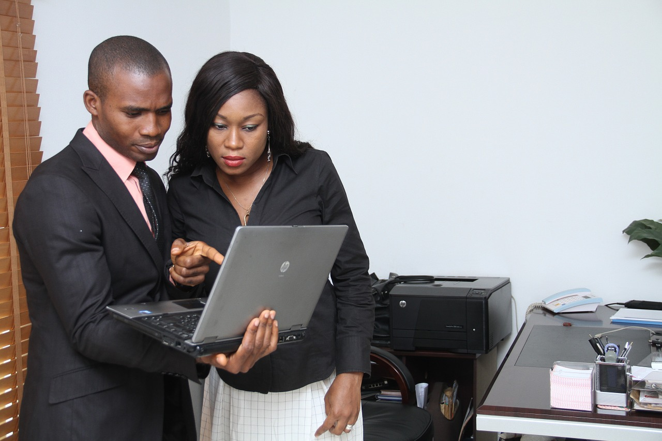
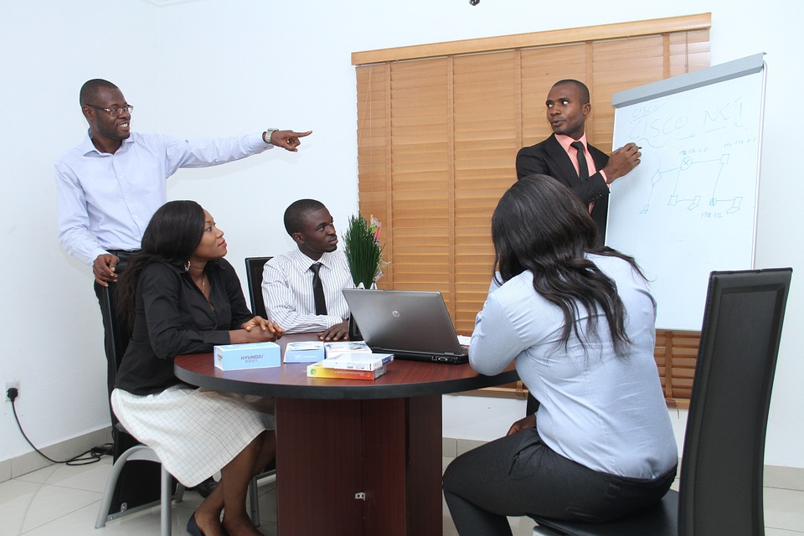

Cultural Challenges
In an office
Creating a workplan
On a project
Making decisions

Slide 6
Dealing with difference
What annoys you – think about working ethic, timing, actions
Compare with your group – which do you think are personal and which are cultural?
Think about it from the opposite perspective – why do you think others act, speak that way?
How can you share how you feel in a constructive and understanding way?

Slide 7
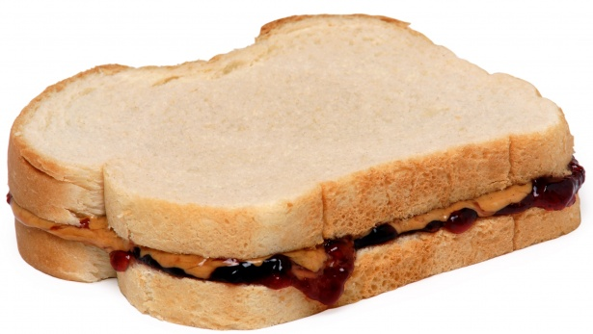
FEEDBACK SANDWICH

Slide 8
CHECKLIST FOR WORKING IN INTERNATIONAL ENVIRONMENTS:
Be approachable – being open and friendly will help you colleagues feel comfortable sharing their thoughts and concerns with you.
LISTEN & summarise often – if someone is sharing something with you, do not multi-task if possible, to show them you are professional and attentive. To show them that you have understood and listened, summarise what they have said to you.
Be realistic – Do not say that you can/will do something if you think it is not possible. It is better to say, ‘Let me check if I have the resources/ availability to complete the task’ rather than ‘yes’ and then hand in the work incomplete or late. It is better for both of you. Don’t be afraid to say, “I don’t know, but I’ll find out”.
Mirror your Words & Actions – Make sure your body language (non-verbal communication) mirrors/ matches what you say (verbal communication).
Be positive - Instead of negative criticism, use constructive feedback when dealing with conflict. Instead of saying ‘Stop speaking about me!’, start instead with a positive statement ‘I really respect you’, followed by the issues ‘when you speak about me to other colleagues I feel disrespected’, followed by another positive ‘I’d really like to resolve our issues and keep a good working relationship.’

Slide 9
AIM:
To get you to think first about: how we can judge others without intention, how it is in fact the small similarities that can help us work in harmony together, and that there are always reasons behind how another person is acting or reacting.
If we can remember those three important aspects (JUDGEMENT, SIMILARITIES, THE CULTURAL TREE) and give feedback in a constructive way, our working environments will be happier and healthier places.
.

Slide 10
“We go on and on about our differences. But, you know, our differences are less important than our similarities. People have a lot in common with one another, whether they see that or not.”
William Hall 1821 – 1904
There are really basic similarities between human beings.

